Slide 1
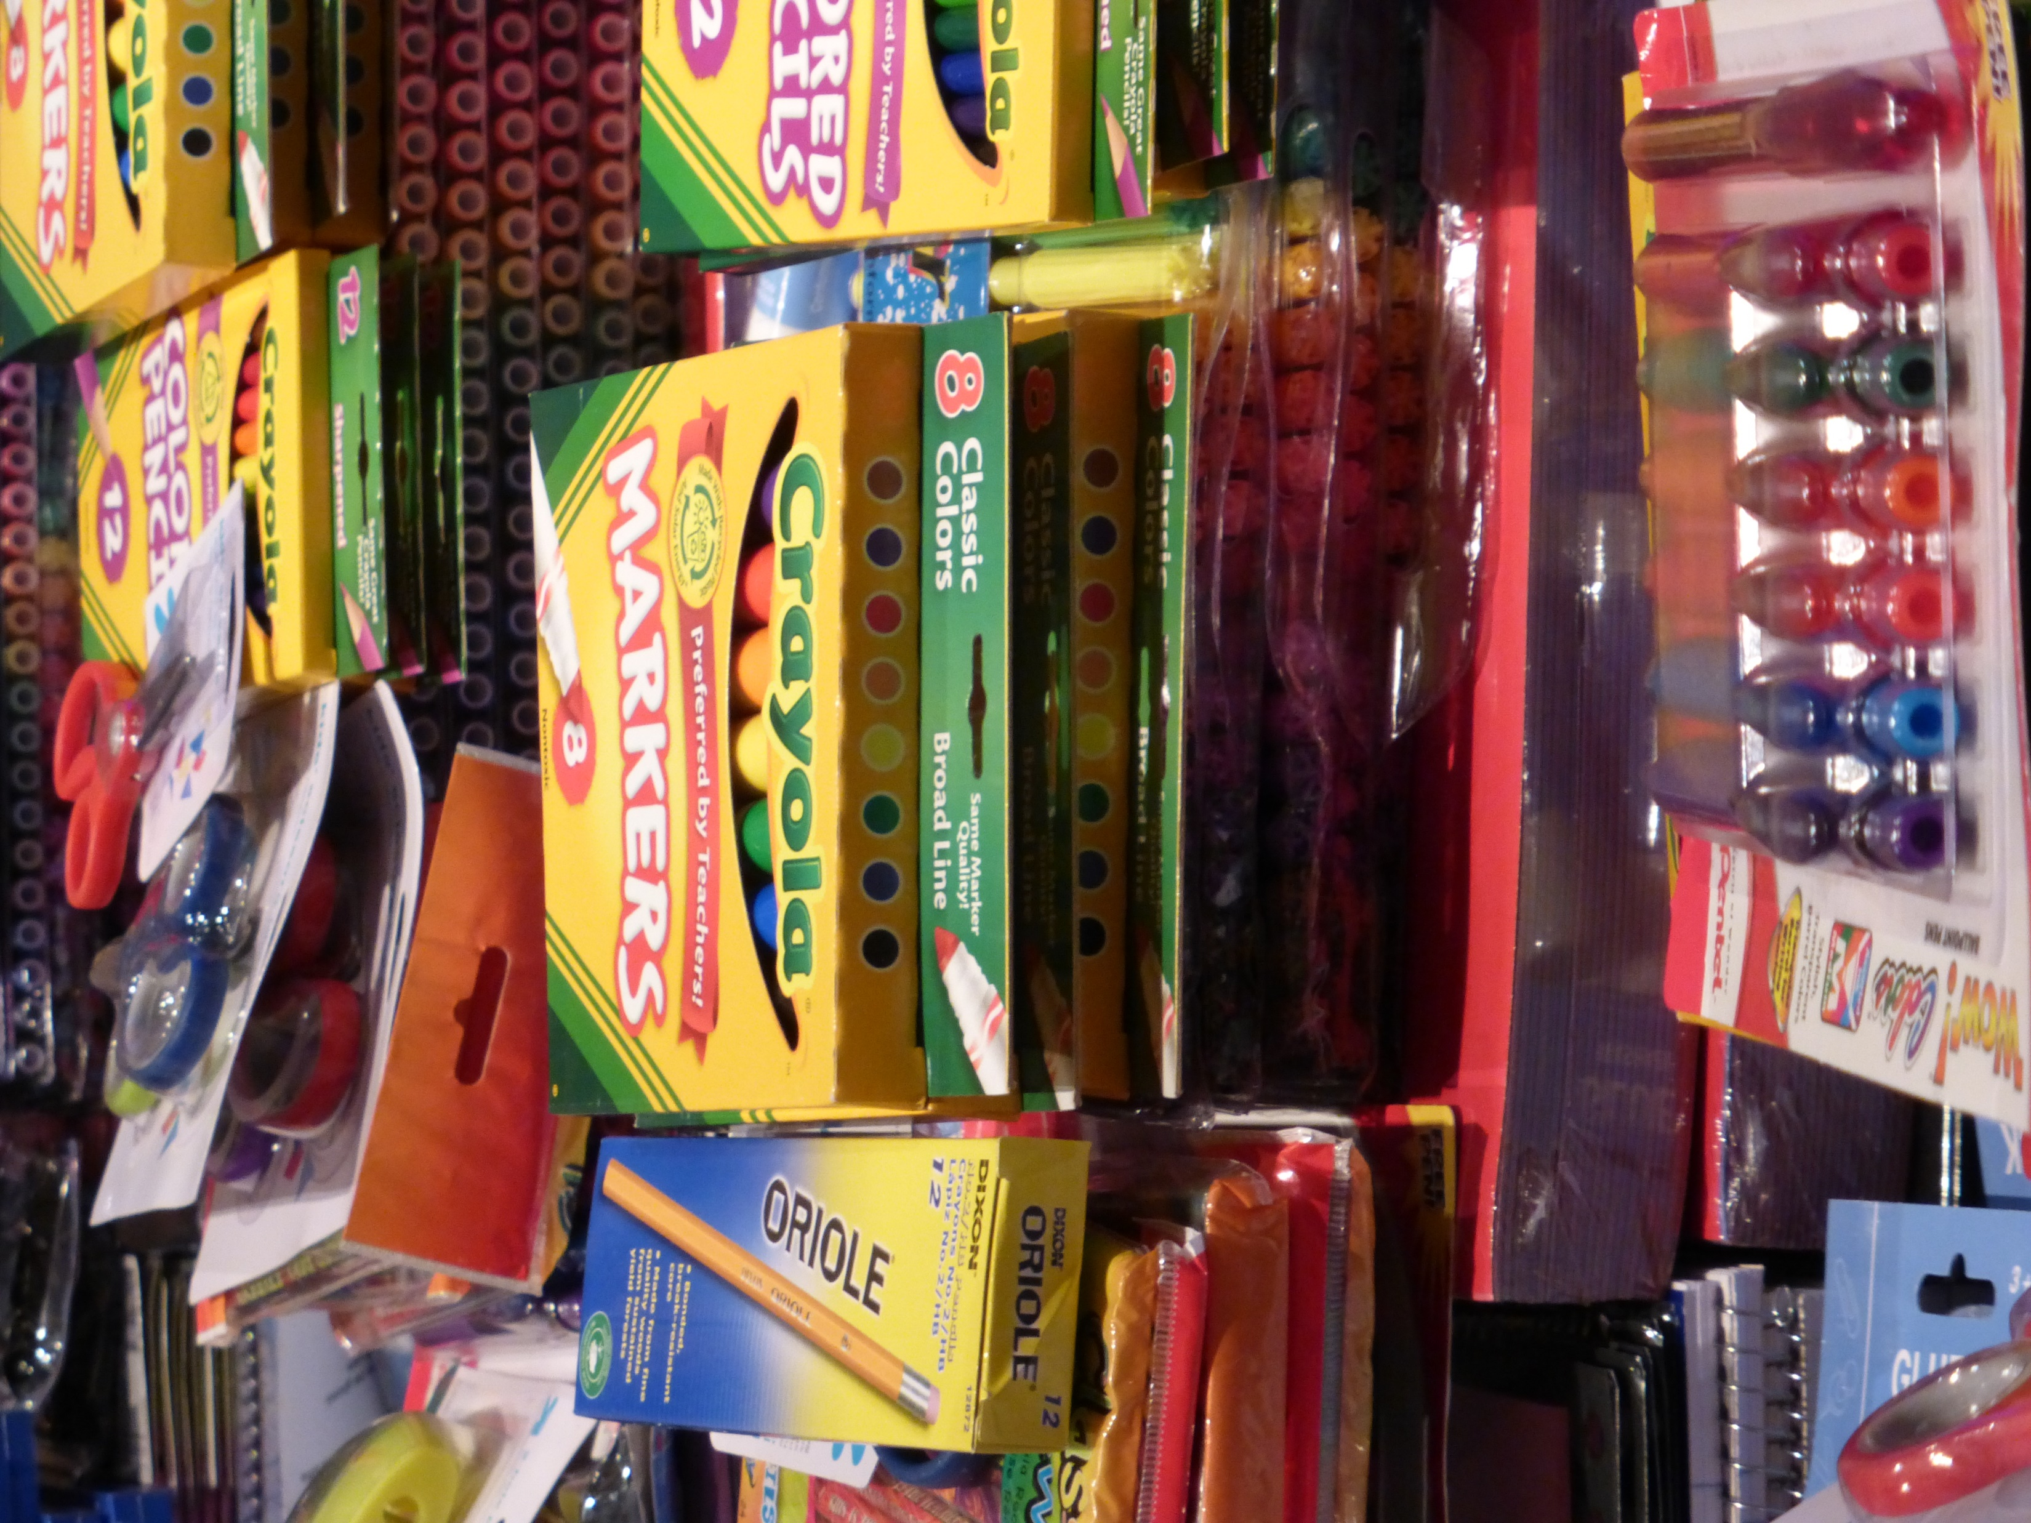
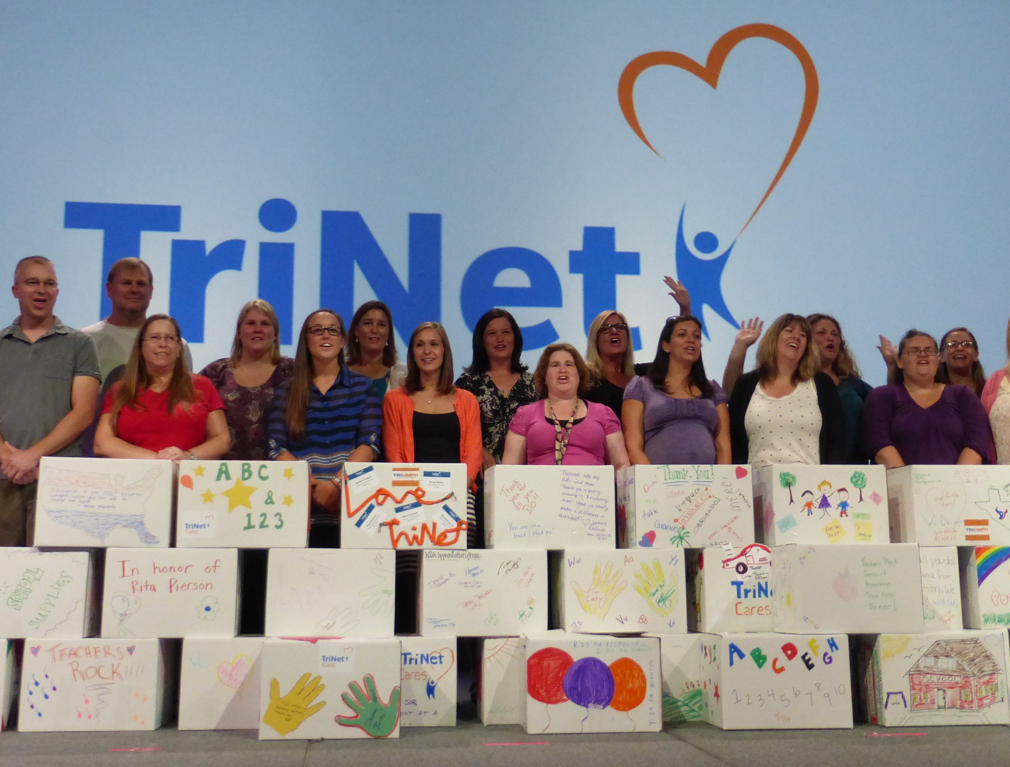
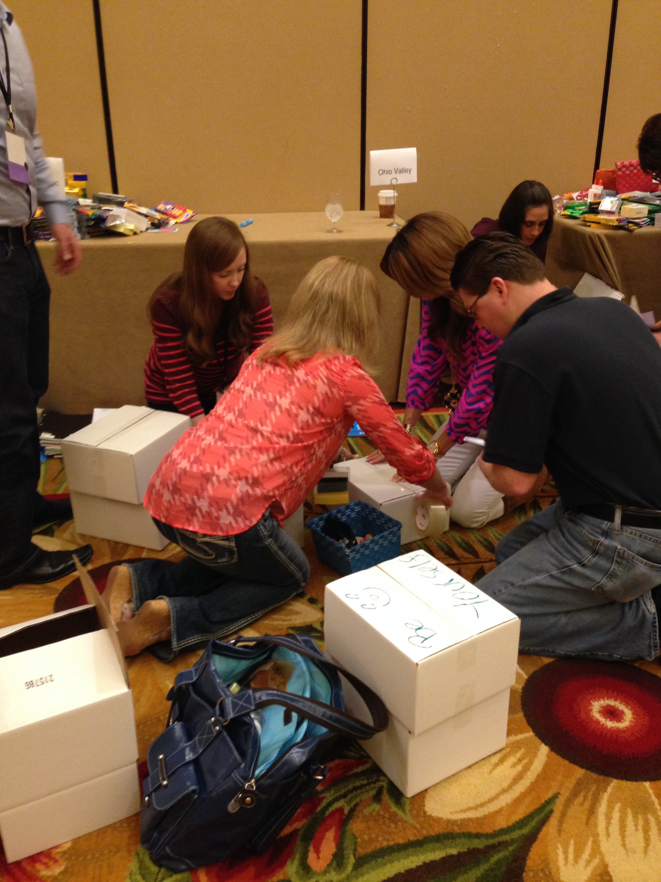
Supply
Showdown
Unleash your Competitive Spirit for a Worthy Cause
60 to
120 min
Players 10 –
Unlimited
Live
Indoor
Outdoor
Intro
The "School Supply Showdown" is an exhilarating charity event that combines friendly competition with the joy of giving back. The event aims to raise team spirit and donate school supplies to underprivileged children in the community. On the event day, teams are formed and various challenges and games are held to test their skills, creativity, and teamwork.
Throughout the event, teams encounter "School Supply Pit Stops" where they complete tasks or challenges to earn additional supplies for their donation goals. At the end of the event, awards and recognition are given to the teams with the highest scores. By participating in the School Supplies Showdown, individuals support a worthy cause, foster team spirit, make a lasting impact, unleash their competitive spirit, and create lasting memories. The event aims to inspire a brighter future by championing education, teamwork, and compassion.
Icebreaker
Strategy Stage
90 Minutes
Activity
Charity Speaks
Group Picture

