Slide 1
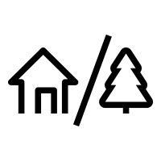
GAP
The
Constructing Bridges….Bridging Communities
90 to
120 min
Players 10-Unlimited
Live
Indoor
Outdoor
An age-old challenge to the genius of man and engineering science! Today your teams will tackle and answer the question – can we bridge the gap between our teammates while at the same time building a bridge to carry one of our teammates?
Unleash the power of teamwork, harness imagination, and witness the exhilarating triumph of accomplishing the "impossible" while strengthening communication, trust, and belief in achieving goals together. This fast paced "can they succeed" event is perfect for teams who are looking to stretch themselves out of the comfortable and into a world where anything can happen. Get out of your seats and get hands on as teams Bridge the Gap!
Intro
90 Minutes
Building
Competition
Awards

