Slide 1
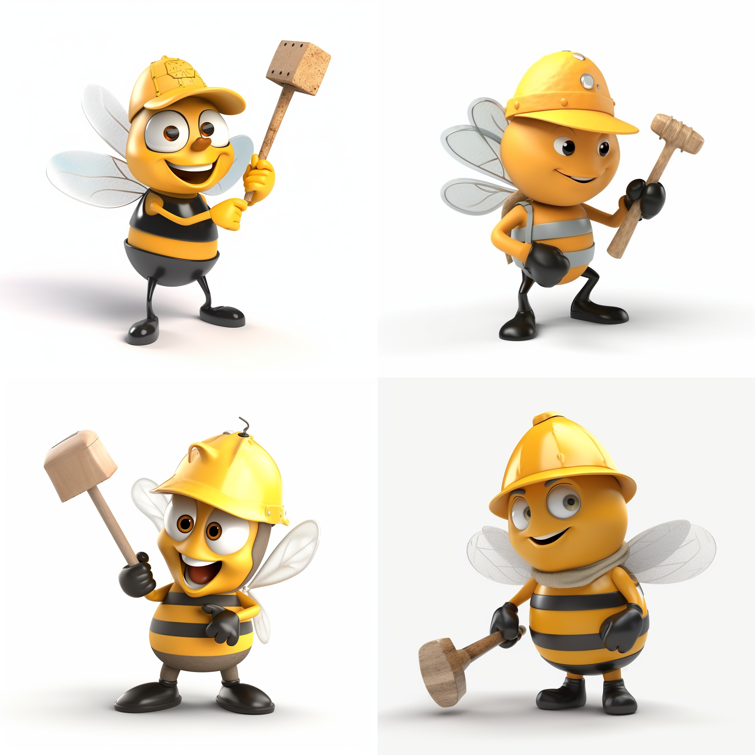





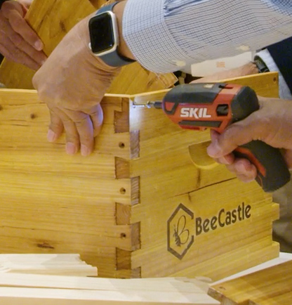
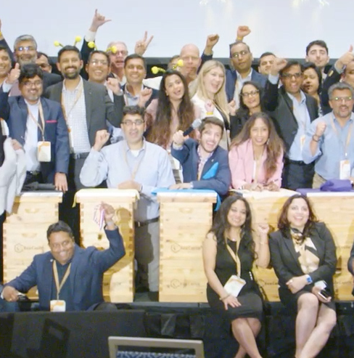
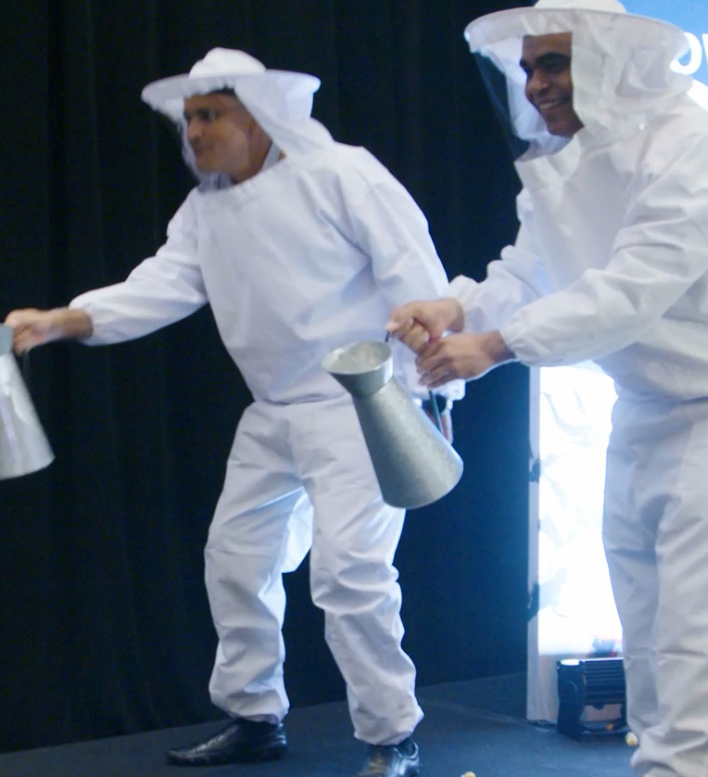
Builders
Fostering Sustainability
60min
120 min
Players 10 –
Unlimited
Virtual
Live
Indoor
Outdoor
Beehive Building is an extraordinary event that combines the best of team spirit, business lessons from the world and work of bees, and community impact. Your teams compete in "hives" and are challenged to construct their own beehives, fostering teamwork, problem-solving, and creativity.
But it doesn't end there. All the beehives built will be donated to local beekeepers or women in impoverished areas, providing a livelihood and educational opportunities. This event highlights the traits that make beehives successful, such as teamwork, communication, and celebration. With high-energy music and an engaging MC, Beehive Building promises an unforgettable experience.
Don't miss the chance to be part of something bigger, where team building aligns with social responsibility. Come create a hive of success while making a positive difference in our community.
Intro
Icebreaker
Strategy Stage
90 Minutes
Building
Present
Charity Speaks
Awards

