Slide 1
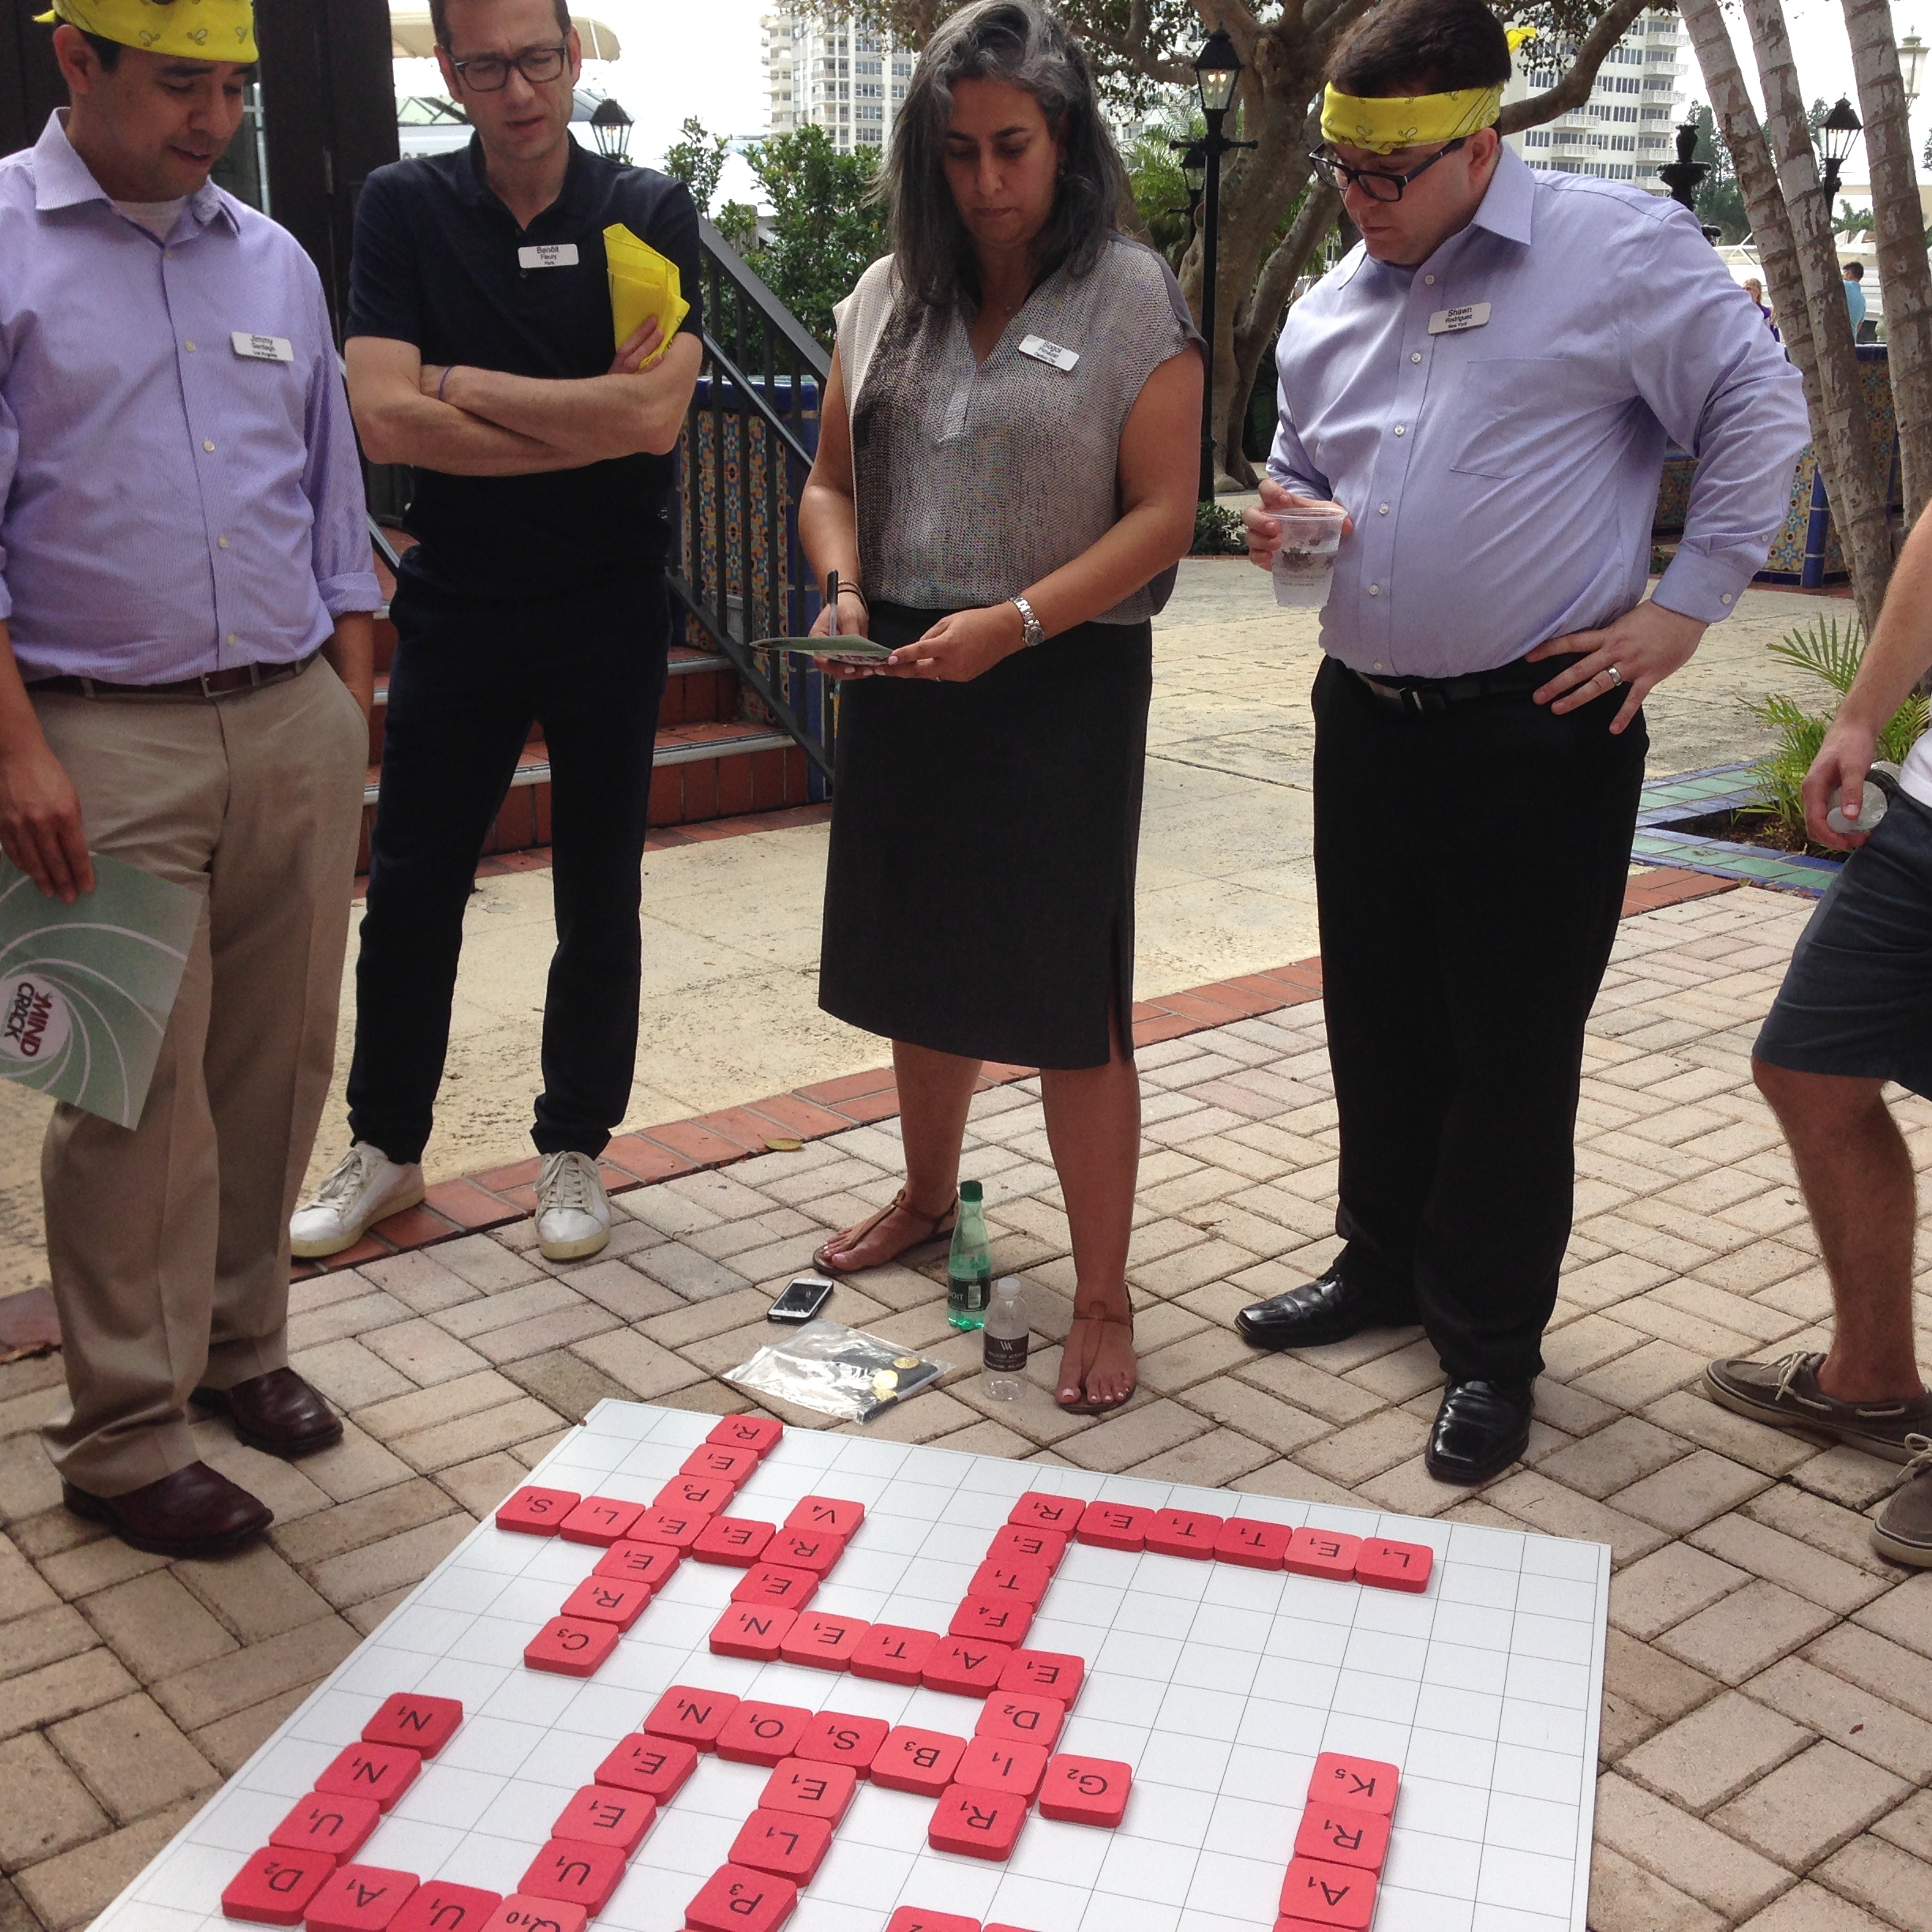
Crack
Shaken….Not Stirred!
60 to
120 min
Players 10 –
Unlimited
Indoor
Outdoor
Live
Do you have the eagle eyes and finely honed skills necessary to be the next 007? If so….the world needs you! Your application has impressed intelligence's top brass, so enter the underworld life of a secret agent. Unleash your boldness, intelligence, creativity, and resourcefulness as you navigate a manipulated environment and uncover hidden solutions. But here's the exciting part: Mind Crack not only offers a thrilling spy experience but also equips you with invaluable skills for the real world. Form alliances or keep your cards close as you strategize with other teams. The clock is ticking, and success depends on having all the correct solutions when you regroup for the grand finale - a live action finish! Mind Crack is the mind-bending challenge that rewards teamwork and camaraderie. Join the elite ranks of aspiring spies - prove your mettle and reap your rewards!
Intro
30 Minutes
Activity
Awards

